Slide 1
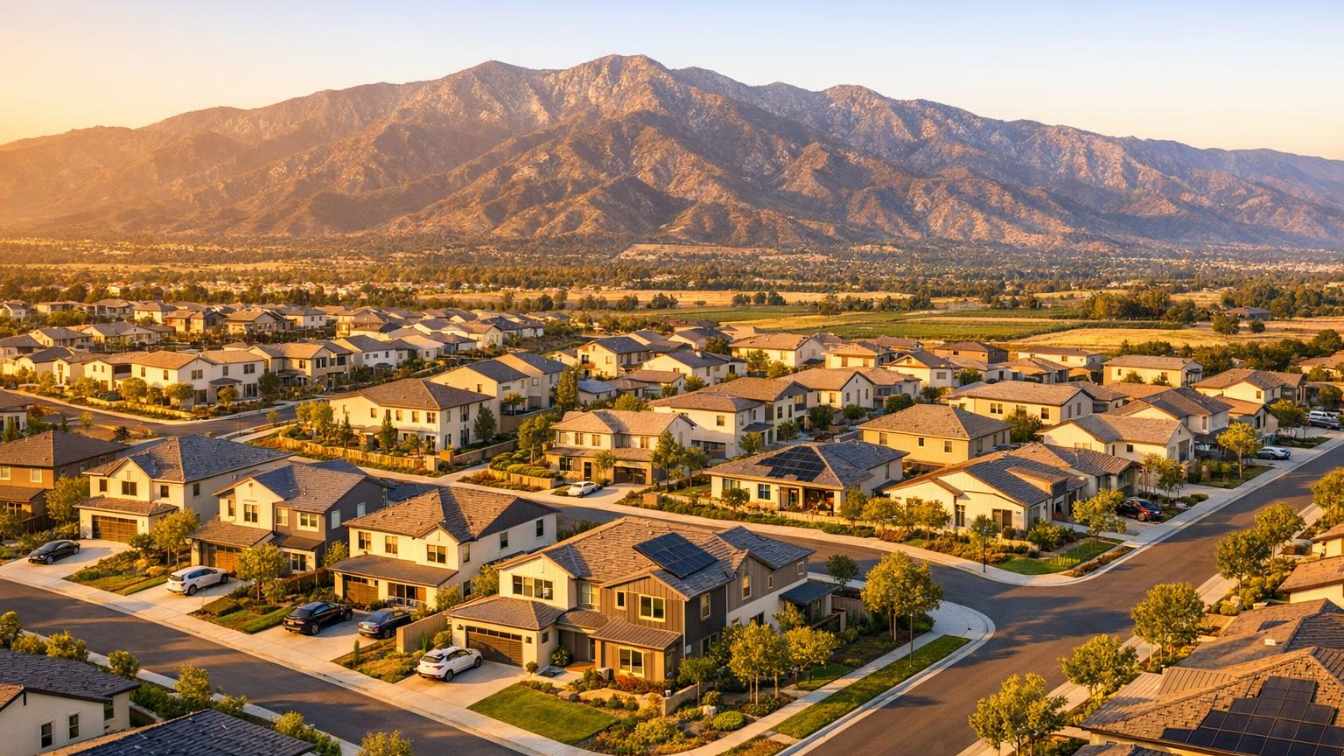
California Housing
& Equity Accelerator
A County-by-County Housing Production &
Equity Creation Pilot Program
Presented by Non-profit Community Catalyst

Slide 2



What Is the Accelerator?
The California Housing & Equity Accelerator (CHEA) is a first-of-its-kind county-by-county housing production and equity creation pilot program.
Not a Traditional Program
Scalable Framework
Economic Engine
Not a one-size-fits-all affordable housing or manufactured housing sales program.
Each county customizes strategies around its own goals, demographics, and priorities.
Lower the cost of producing housing while preserving conventional fair market value.

Slide 3
The Core Concept
Lower the cost of producing housing while preserving conventional fair market value.
Factory-built housing developed under coordinated cost-reduction systems can still appraise and perform within the conventional housing market at fair market value — even when the actual cost of development has been significantly reduced.
This creates one of the most important opportunities in housing development:
Immediate Equity Creation

Slide 4
Immediate Equity Creation
Traditional Model
Homeowners, developers, and investors wait years or decades to build meaningful equity through appreciation and mortgage paydown.
Accelerator Model
By reducing the cost basis of housing production itself, participants may create substantial equity positions immediately upon project completion.
Who Benefits Most
First-time homebuyers
Workforce families
Moderate-income households
Private investors
Real estate professionals
Small developers
Community housing organizations
Rural housing initiatives

Slide 5


Building a Collaborative Ecosystem
Public-interest housing goals and private-sector housing investment operating together — not competing.
Public & Community
Private & Market
Local governments
Housing nonprofits
Community-based organizations
CDFIs
Local banks
Mortgage brokers
Real estate developers
Private equity groups
Contractors & skilled trades
Factory-built housing manufacturers
Real estate professionals
Community investors

Slide 6
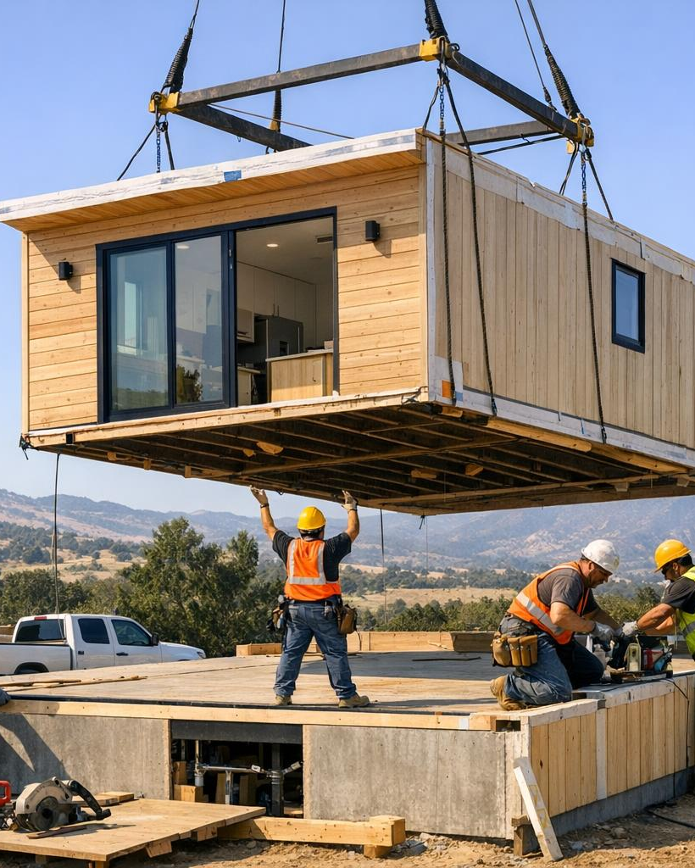
Non-profit Construction Corporation (NPCC) developed this model through real-world implementation in rural California communities.
A Proven
Housing
Production
Concept
EIN 99-1958124
Established nonprofit entity
CSLB #1125441
Licensed contractor
El Dorado County
Multiple housing projects demonstrating reduced costs with strong market demand
Evolved Model
Now adapted for multiple income levels and market sectors

Slide 7



Why Factory-Built Housing?
The most realistic opportunity to dramatically reduce housing production costs while accelerating timelines.
Material Waste
Construction Timelines
Retail Markups
Development Inefficiencies
Financing Carry Costs
Labor Bottlenecks
The objective is to integrate factory-built housing as a mainstream production tool — not replace conventional construction.

Slide 8
A Flexible County-by-County Framework
Each participating county customizes the framework around its own housing priorities, demographics, land availability, and development goals.
Housing Program Examples
County Participation
"Build in Our County" incentive programs
Workforce housing initiatives
Starter home developments
Shared-equity housing models
Veteran housing initiatives
Rural housing expansion
ADU and infill housing strategies
Permit fee reductions or waivers
County-owned surplus land opportunities
Infrastructure coordination
Flexible zoning strategies
Expedited permitting
Public-private development partnerships
Housing trust fund participation

Slide 9
Pilot Rollout & Partnership Structure
Pilot Launch Prerequisites
NPCC's Pilot Phase Role
Memorandum of Understanding (MOU) executed
Two-year pilot proforma budget identified and funded
County participation goals and objectives established
Initial program implementation
Housing production coordination
Partnership development
Industry & lender engagement
Community outreach support
Technical guidance
Training & operational support
Long-Term Vision
Help counties and local organizations establish sustainable local housing production ecosystems capable of operating independently within approximately two years.

Slide 10
Conventional Market Participation
Lowering the actual cost of housing production improves project feasibility across nearly every segment of the housing market.
Designed to Attract
Target Development Types
High-income real estate professionals
Private equity groups
Developers & investors
Mortgage & construction finance
Housing nonprofits & community developers
Single-family starter homes
Workforce housing developments
Duplex & small multifamily
Scattered-site housing
Rural infill housing
Mixed-income developments

Slide 11



Financing New Manufactured Home Construction
Every mechanism framed as an opportunity — not an obstacle.
FHA One-Time Close
VA Construction-to-Permanent
USDA Single-Close (502)
580+ credit
580–620 typical
640+ for auto-approval
3.5% down
0% down
0% down
Most accessible path for buyers with income but limited cash reserves. Single-close loan with land flexibility.
The only true zero-down construction loan in America. No PMI and some of the lowest rates in the market.
Zero-down construction financing for rural areas with subsidized interest rates. Perfect for manufactured homes.

Slide 12


Conventional & Investor Financing
Options for well-qualified borrowers, investors, and high-net-worth participants.
Conventional (Fannie / Freddie)
Investor & High-Net-Worth Options
Credit Score: 620+, prime pricing at 700+
Down Payment: 5–20% depending on profile
Loan Limits: Higher than FHA for larger projects
Best pricing and lowest lifetime cost of ownership for well-qualified borrowers with strong credit and assets.
DSCR Construction Loans
Based on rental income, not personal income
Portfolio Bank Loans
Relationship-based, flexible terms and custom draws
HELOC-Backed Construction
Use equity from another property, close in days
Cash + Refinance Strategy
Build with cash, then refi into FHA/VA/Conventional

Slide 13


Alternative Financing Paths
Speed, simplicity, and flexibility for borrowers who need non-traditional solutions.
Chattel Loans
Private & Hard Money
Credit Score: Often 600+
Down Payment: 5–20%
Fastest approvals and lowest documentation requirements. Perfect for buyers who want speed, simplicity, or who are placing a home on leased land.
Credit Score: Not the main factor
Down Payment: Typically 20–30%, negotiable
Zero red tape. Ideal for land-rich, cash-poor borrowers or those needing immediate starts. Maximum flexibility and control.

Slide 14
Financing at a Glance
Every path is an opportunity to build.
Program | Min. Credit | Down Payment | Best For
FHA One-Time Close | 580 | 3.5% | Buyers with income but limited savings
VA Construction | 580–620 | 0% | Veterans — zero down, no PMI
USDA 502 | 640 | 0% | Rural borrowers with subsidized rates
Conventional | 620+ | 5–20% | Strong credit, lowest lifetime cost
DSCR / Portfolio | Varies | Varies | Investors and high-net-worth borrowers
Chattel Loans | 600+ | 5–20% | Speed and simplicity, leased land
Private / Hard Money | Flexible | 20–30% | Land-rich borrowers, immediate starts

Slide 15
Multigenerational Shared-Equity Homeownership
Two homes, one parcel, shared ownership — an FHA-compliant pathway for families who are stronger together.
Core Concept
This program enables two manufactured homes to be placed on a single parcel from the start of development. One home is permitted as the primary residence; the second as an Accessory Dwelling Unit (ADU).
Both households share ownership as tenants in common, creating a co-ownership structure that reduces individual financial burden while allowing both families to build equity over time.
Integrated Planning Advantage
Instead of adding an ADU later — requiring new permits and costly retrofits — the program designs land, utilities, and site layout for both homes from the beginning, significantly reducing total development costs.
FHA Compliance Requirements
Permanent foundation required for all manufactured homes
HUD certification labels on all factory-built units
Primary-residence occupancy requirement met
Compliant site utilities and road access
ADU permitted under local zoning alongside primary residence
Tenants-in-common co-ownership structure fully documented

Slide 16
Benefits for Participating Families
Long-term stability and affordability through shared responsibility and multigenerational support.
Family & Financial Benefits
Purpose & Impact
Lower overall cost of living through shared mortgage responsibility
Reduced infrastructure expenses by building both homes simultaneously
Multigenerational support including shared childcare, household duties, and daily living assistance
Equity growth for both families as the property appreciates over time
Greater stability and community connection through long-term homeownership
This program provides a structured, FHA-compliant pathway for families who might not qualify for homeownership on their own.
By combining shared equity, multi-unit planning, and accessible financing, it creates a sustainable model for affordable, multigenerational living and long-term financial stability.
Multiple borrowers working together can achieve homeownership that would be out of reach individually — lowering costs and building equity as a family unit.

Slide 17
FHA One-Time Close for Co-Ownership
Land purchase, construction, and permanent mortgage combined into a single loan process.
How It Works
Key Advantages
The FHA One-Time Close (All-in-One) Construction Loan combines land purchase, construction financing, and permanent mortgage into a single loan.
This eliminates the need for multiple loan approvals or refinancing after construction. Multiple borrowers can qualify together, combining income to meet FHA requirements.
Recent FHA updates now support multigenerational and multi-borrower arrangements, making this structure increasingly accessible for co-ownership models.
Single loan process from start to finish — no multiple approvals needed
Lower down payments compared to conventional construction loans
Competitive interest rates backed by FHA insurance
Flexible credit requirements, making the program accessible to more families
Simplified construction-to-permanent transition reduces financial stress during the build
Combined borrower income strengthens qualification for larger loan amounts

Slide 18
How It Works
From partnership to independent local production in four phases.
01
02
03
04
County Partnership
Fund & Plan
Build & Produce
Scale & Transfer
Execute MOU and establish pilot goals with participating county government
Identify two-year operating budget and set housing production targets
Coordinate factory-built housing delivery with cost-reduction systems
Transition operational capability to county and local organizations

Slide 19

The Pilot Evolves Over Time
The framework is intentionally designed to adapt based on:
Local Housing Priorities
County Policy Goals
Workforce Needs
Economic Development
Community Feedback
Infrastructure Realities

Slide 20
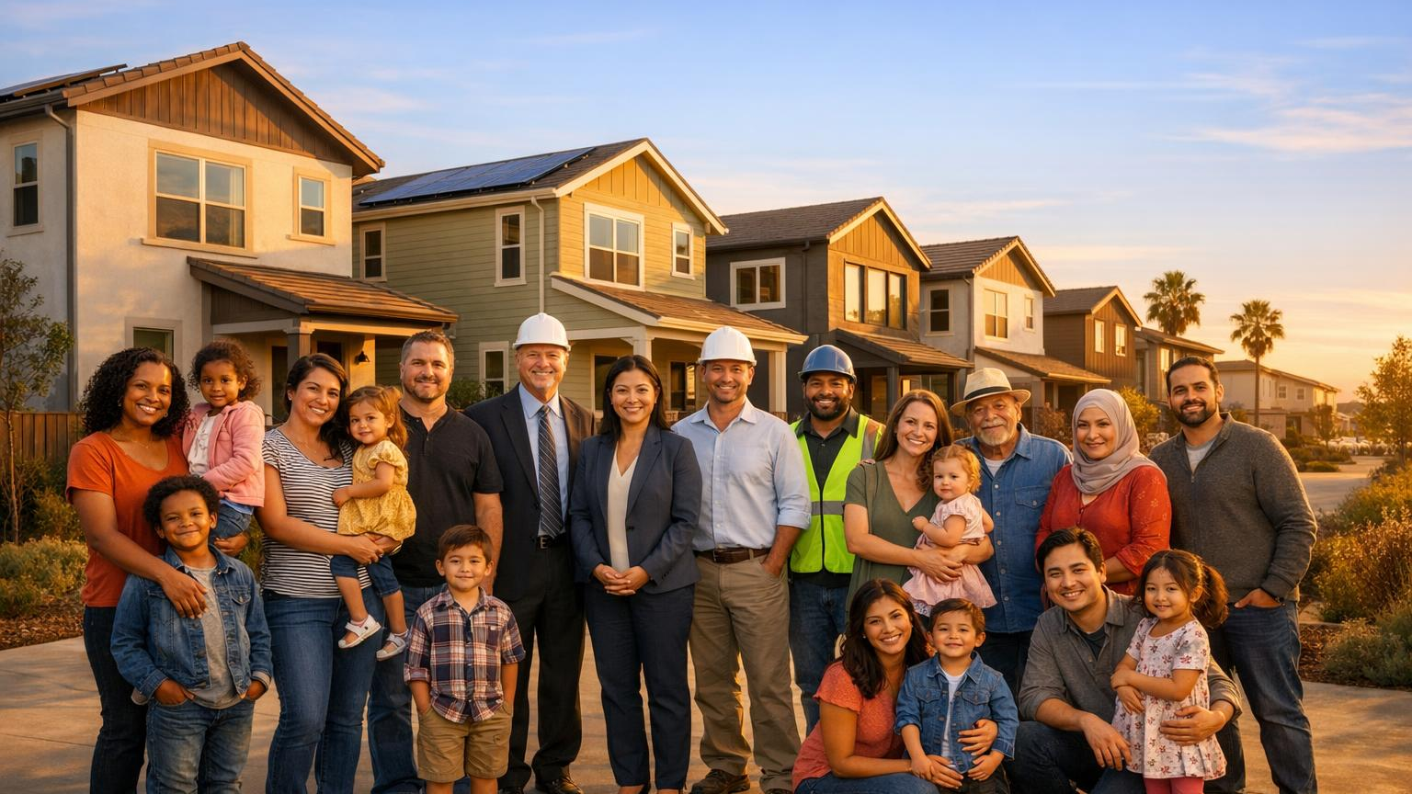
The Goal
Build more housing
Lower the cost of housing production
Create immediate equity opportunities
Expand attainable homeownership
Attract conventional investment
Increase local economic activity
Meet RHNA goals
Strengthen communities
A replicable county-by-county housing production framework
capable of restoring housing development as an achievable process.

