Slide 1
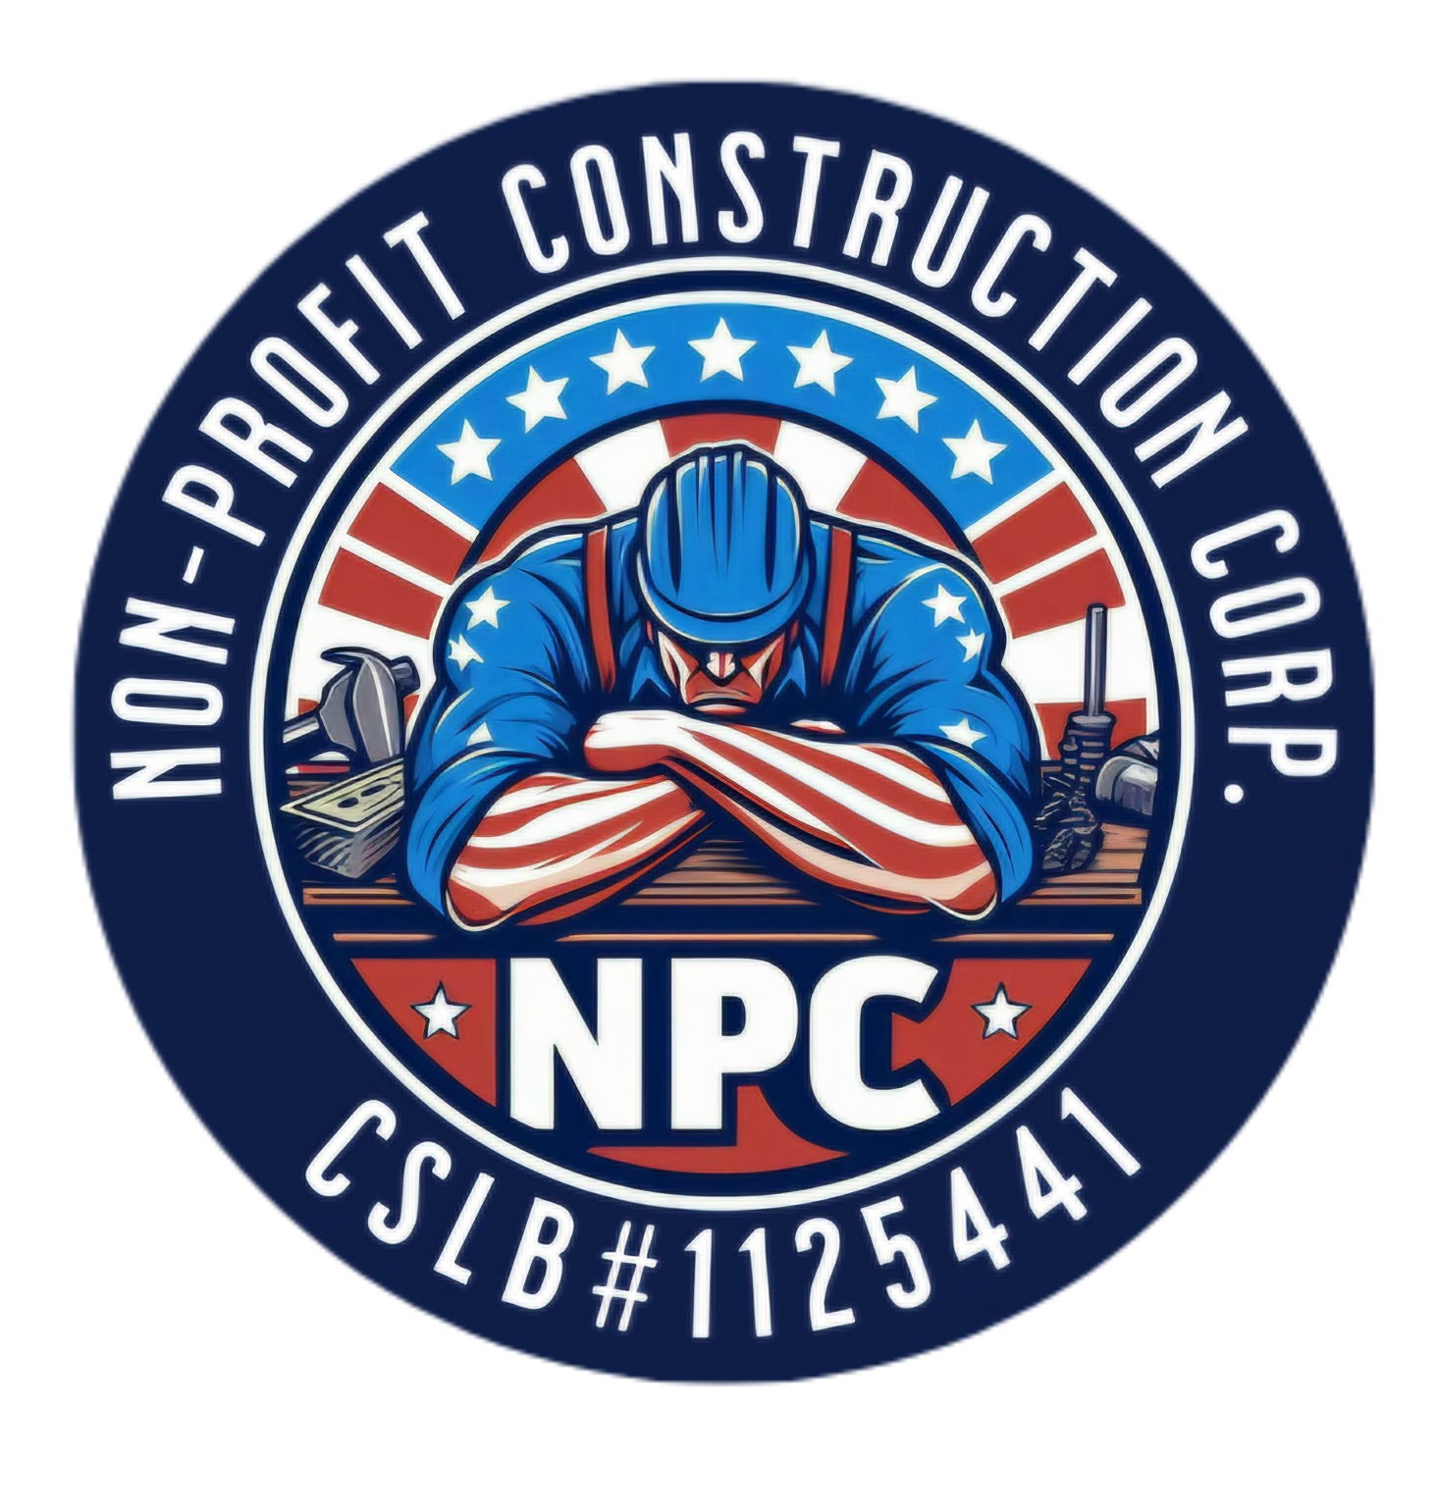
Blueprint for Resilient Recovery: Tuolumne County’s Community-First Response to the Chinese Camp CZU Lightning Complex Fire
Collaborative strategies for wildfire recovery and community resilience
Notes:
AI-generated content may be incorrect. --- This presentation explores Tuolumne County’s comprehensive, community-centered recovery response to the Chinese Camp CZU Lightning Complex Fire. We will examine the fire’s impact, collaborative recovery efforts, immediate strategies, ongoing support programs, and sustainable community reinvestment plans.

Slide 2
Presentation Agenda
Establishing the Recovery Framework: Tuolumne County and NPC Partnership
Immediate Action Strategies for Recovery
Expanding Community Support: NPC Base Programs in Tuolumne County
Sustainable Recovery and Community Reinvestment
Notes:
We will begin with an overview of the fire event and its impact on Tuolumne County. Next, we will discuss the recovery framework developed with NPC partnership. Then, immediate recovery actions will be reviewed, followed by NPC’s broader community programs. Finally, we will cover sustainable recovery and reinvestment.

Slide 3
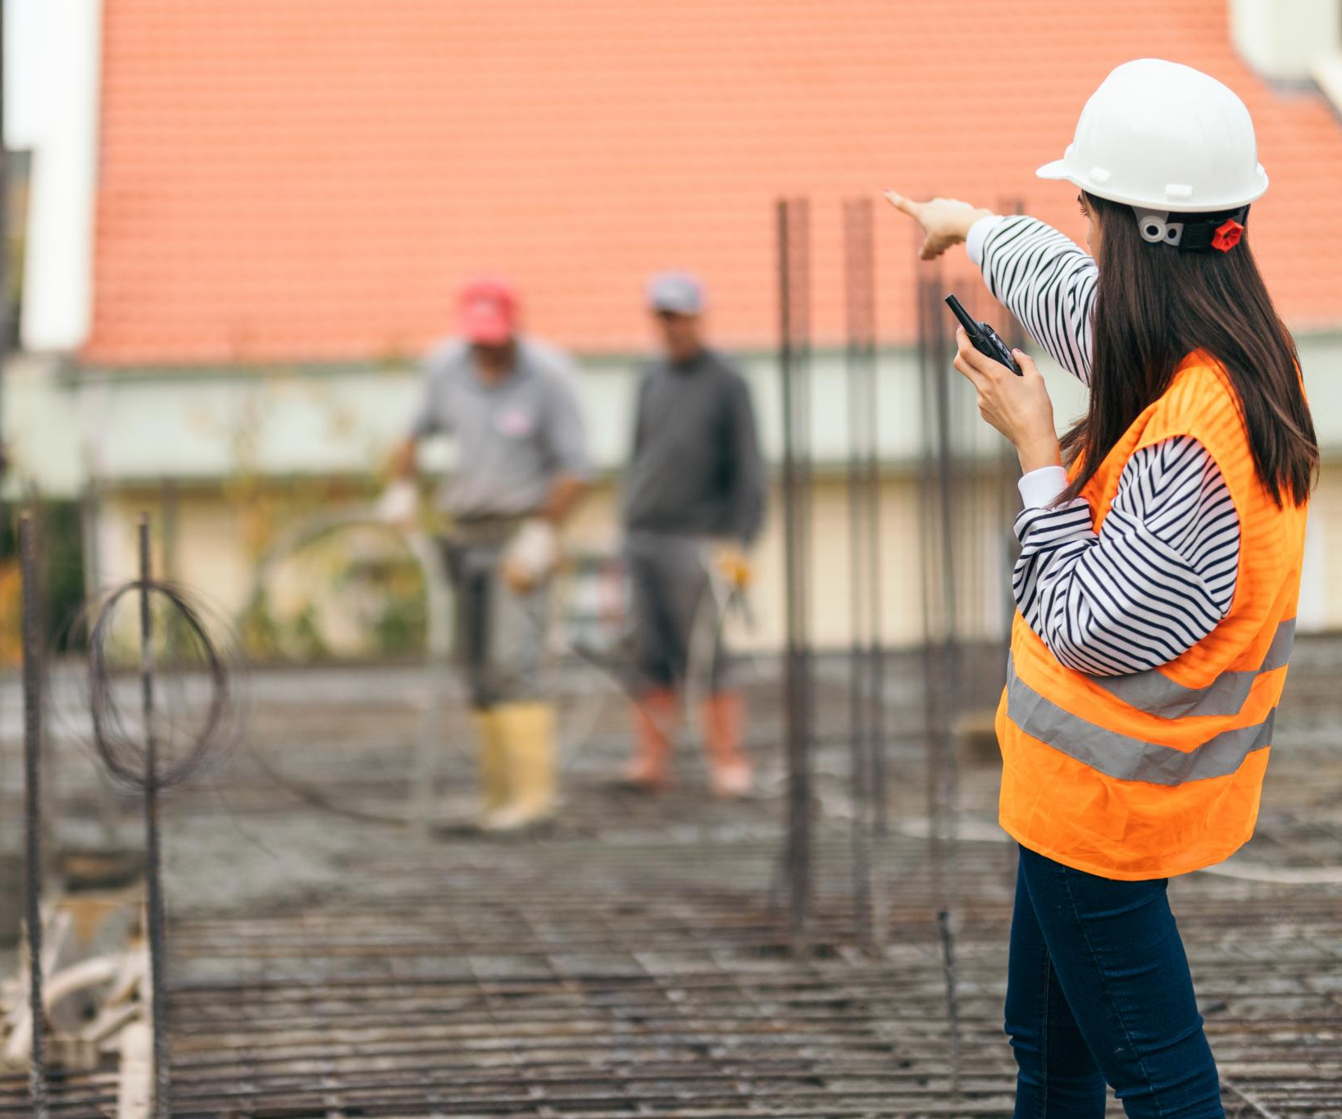
Rationale for Urgent Recovery Efforts
Preventing Prolonged Displacement
Urgent recovery stops long-term displacement, helping residents return to safe homes quickly and securely.
Economic Stabilization
Rapid recovery supports local businesses and prevents economic decline, fostering financial stability for communities.
Community Cohesion and Resilience
A community-first approach strengthens social bonds and resilience to future challenges by addressing residents’ needs.
Notes:
--- Rapid and effective recovery was critical to prevent prolonged displacement, economic decline, and loss of community cohesion. A community-first approach ensures that recovery meets residents’ needs and fosters resilience. Image source: Microsoft 365 content library

Slide 4
Establishing the Recovery Framework: Tuolumne County and NPC Partnership
Notes:
Tuolumne County partnered with the Nonprofit Corporation (NPC) to design a structured recovery framework focused on sustainable, community-led rebuilding and support.

Slide 5
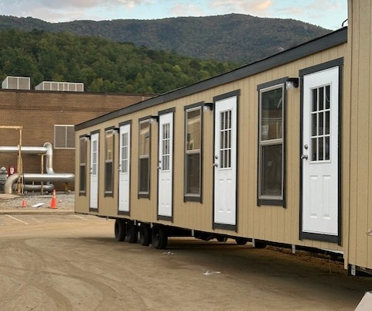
Emergency Bridge Housing Solutions
Temporary Shelter for Homelessness
Emergency bridge housing offers immediate, safe shelter to people experiencing homelessness and wildfire displacement
Connection to Support Services
Residents receive case management through local providers for employment assistance with NPC once dispatched and other support services to help address underlying challenges.
Pathway to Permanent Housing
This transitional option helps stabilize lives, guiding individuals toward obtaining permanent housing solutions.
Notes:
Image source: Microsoft 365 content library Emergency bridge housing provides temporary shelter to individuals experiencing homelessness. It offers safe accommodations while connecting residents to support services such as case management and employment assistance. This transitional housing option helps people stabilize their lives as they work toward securing permanent housing solutions.

Slide 6
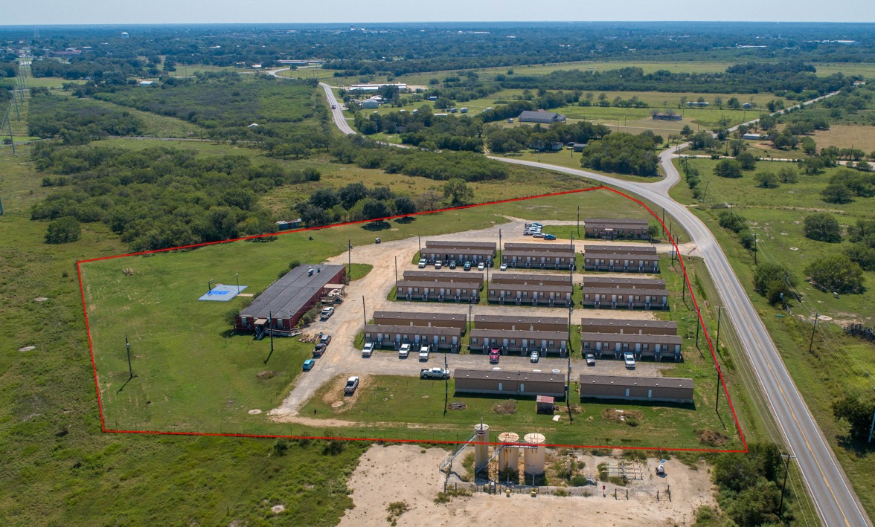
Emergency Bridge Housing Solutions
Immediate Shelter For Displaced People
Emergency bridge housing offers swift shelter solutions for individuals displaced by disasters like wildfires, supporting urgent community needs.
Transition to Long-Term Housing
Once stabilized, these units can serve as permanent homes, adapting to the evolving needs of the community.
Portability and Site Flexibility
Portable design allows housing units to be relocated or permanently installed at various sites, meeting changing demands.
Notes:
Image source: Microsoft 365 content library Emergency Bridge Housing provides immediate shelter for displaced individuals, especially after wildfires. Once stabilized, these units can transition into long-term housing, offering flexibility for evolving community needs. Their portability allows for permanent installation at different sites, addressing both disaster response and the ongoing demand for affordable housing in affected communities.

Slide 7
Emergency Bridge Housing Impact
Essential Onsite Facilities
Laundry rooms and dining halls in emergency housing support the daily needs of displaced individuals and families.
These facilities help facilitate the normalcy of every day life helping parents keep up with their children, work attire and when used for transitional housing helps individuals find routine, employment and self pride.
Community Events and Cohesion
Housing spaces host events and meetings, strengthening social ties and providing updates on rebuilding efforts. Having a hall for all displaced to meet and gather together provides a space for transparency and collaboration. As well, a place for holidays, birthdays, social events and local government communication so that vitial informative updates can be made.
Central Hub and Daycare
A central hub and onsite daycare help prevent abandonment and blight, supporting the community’s stability and daily life. With coordination from local organizations, Health and Human service agencies and resident collaboration daycares are one of the biggest needs for low and moderate income families that not only face displacement but with the daily cost of living.
Notes:
Image source: Microsoft 365 content library Emergency Bridge Housing offers essential onsite facilities like laundry and dining halls, supporting daily life for displaced communities. These spaces host community events, government meetings for rebuilding updates, and celebrations, fostering social cohesion. By providing daycare and a central hub, this housing helps prevent community deterioration, abandonment, and blight, reinforcing the foundation of community life.

Slide 8

Key Goals of the County-NPC Collaboration
Accelerate Recovery
The collaboration focuses on speeding up recovery processes to help communities return to normal quickly.
Safe Housing Solutions
Providing secure and stable housing is a primary objective to ensure safety for affected residents.
Empower Residents
The partnership and county led initiative empowers residents to actively participate in rebuilding and decision-making processes.
Build Community Resilience
Long-term resilience is built through coordinated efforts to withstand future challenges. Incorporating future community needs of infrastructure to accommodate growth and wildfire resiliency
Notes:
--- The partnership aims to accelerate recovery, provide safe housing solutions, empower affected residents, and build long-term community resilience through coordinated efforts. Image source: Microsoft 365 content library

Slide 9
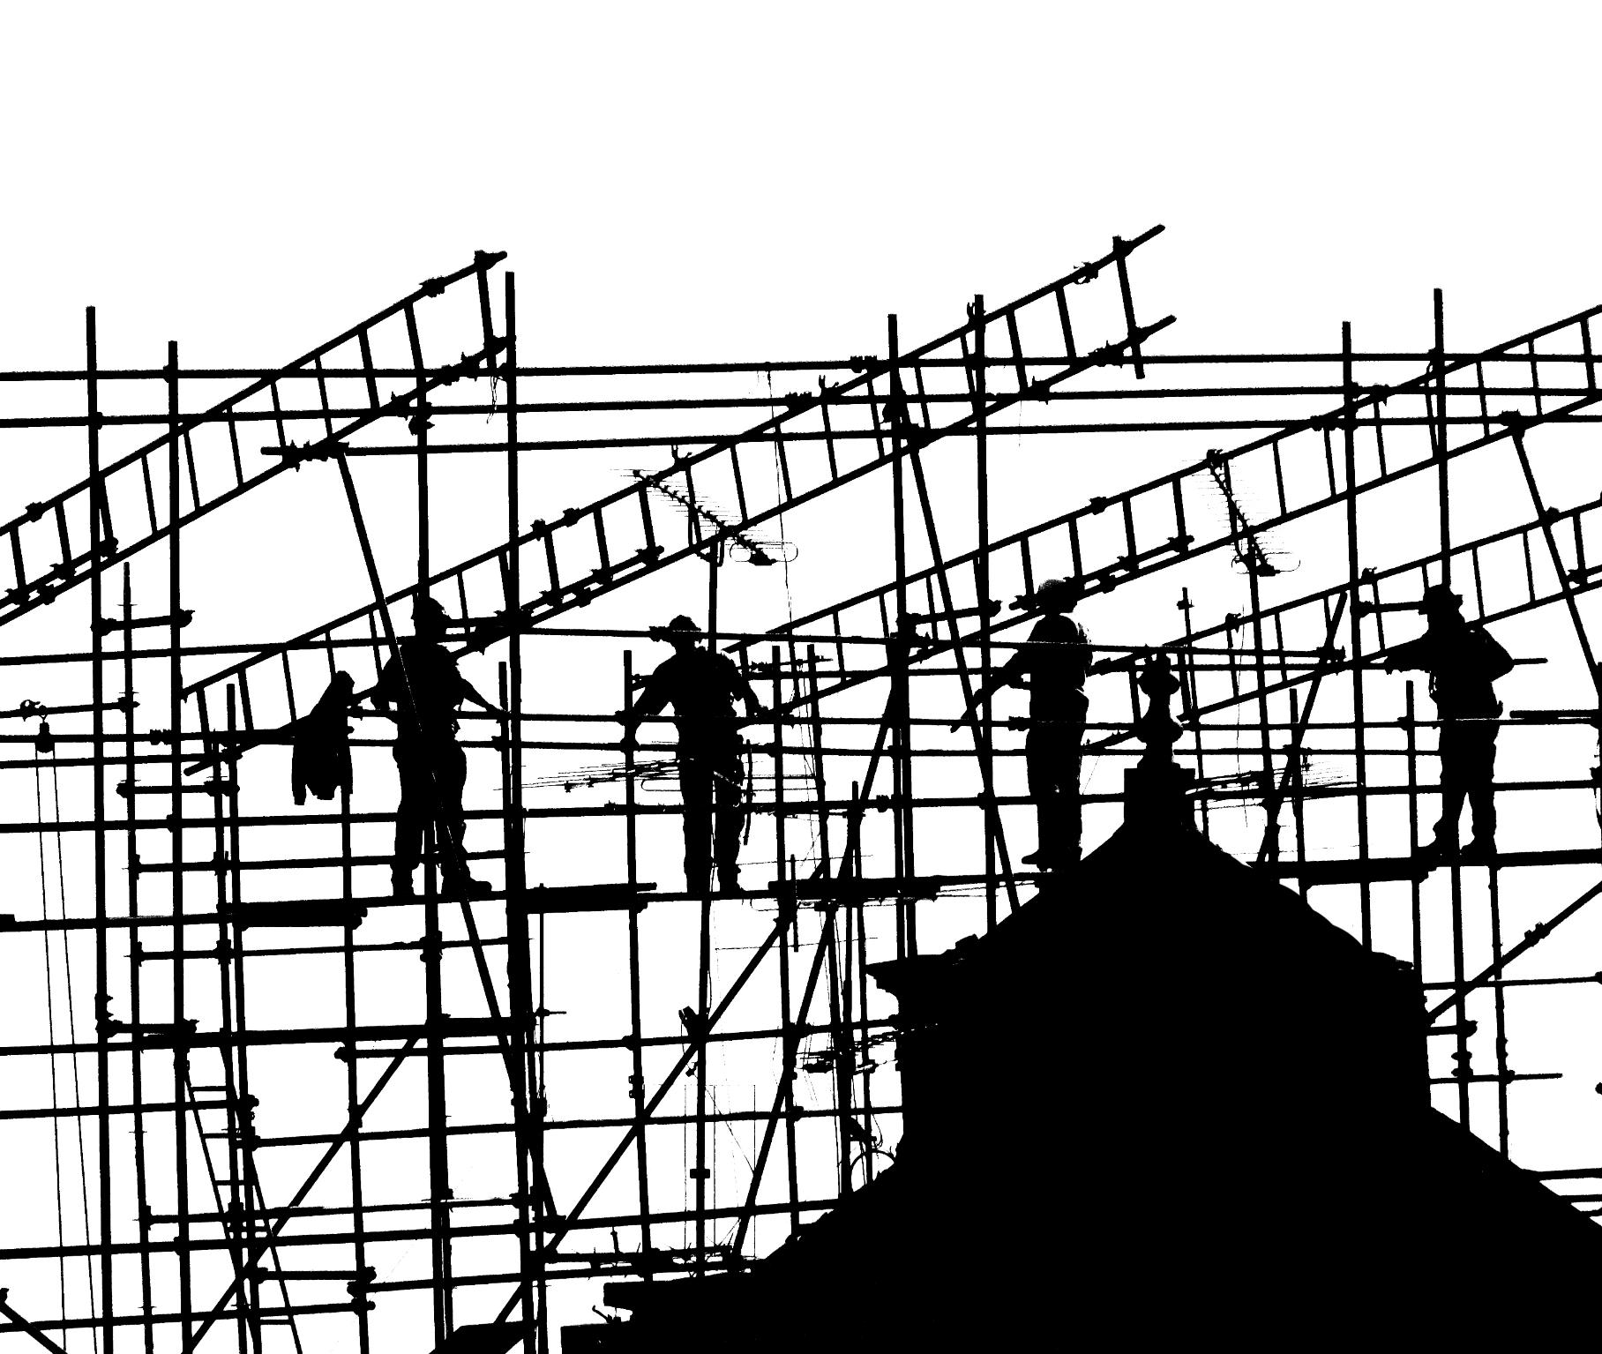
Community-First Recovery Blueprint: Principles and Priorities
Planning for the future while providing housing now
Recovery efforts focus on inclusive though regarding local housing short and long term. What can we do now and how we incorporate those needs for future benefits.
Safety and Fire-Resistant Rebuilding
Rebuilding prioritizes safety by implementing fire-resistant construction standards to protect communities. Working with local resiliency offices and bring in necessary infrastructure to support future resiliency needs.
Sustainable Development
Recovery initiatives aim for long-term sustainability balancing environmental, social, and economic needs. Providing pathways at every point that have long term impacts at a generational level.
Addressing Social Equity
Efforts ensure equitable distribution of resources and support to vulnerable community members during recovery timeline. Investment and or redistribution to the community to bolster its self is a long term goal and vision.
Notes:
--- The recovery blueprint emphasizes inclusivity, transparency, safety, and sustainable development. It prioritizes rebuilding with fire-resistant standards and addressing social equity within recovery initiatives. Image source: Microsoft 365 content library

Slide 10
Rapid Rehousing and Flexible Transitional Housing Solutions
Quick Access to Housing
Focus on rapidly providing safe temporary housing to meet urgent resident needs during transitions. Making sure to incorporate suitable build sites with infrastructure that is minimal cost to bring in but cam support long term housing development.
Tailored Housing Solutions
Housing options are flexible and customized to align with the diverse needs of residents. Making sure to provide the often overlooked luxury of common principles in a community.
Support During Rebuilding
Temporary housing supports residents while permanent homes are being rebuilt and restored. This means they can maintain employment while not having the burden of rents or mortgage payments. A proavtive way to help effected people catch up on bills.
Notes:
--- Efforts focus on providing quick access to safe, temporary housing options tailored to residents’ needs while permanent rebuilding is underway. Image source: Microsoft 365 content library

Slide 11

Fire-Hardened Construction Standards: WUI Compliance, HardiPanel Siding, Fire Sprinkler Systems
WUI Code Compliance
Homes built to Wildland-Urban Interface codes enhance safety against wildfires through specific construction standards. Either manufactured, modular or site built now incorporate many of these features.
Fire-Resistant HardiPanel Siding
Use of HardiPanel siding provides durable, fire-resistant exterior protection for homes in wildfire zones.
Integrated Fire Sprinkler Systems
Built-in sprinkler systems enhance fire protection by actively suppressing flames in wildfire events and are now enforced by California Codes and standards depending on the size of new homes.
Notes:
--- Rebuilt homes incorporate wildfire-resilient features including compliance with Wildland-Urban Interface codes, fire-resistant materials like HardiPanel siding, and integrated sprinkler systems for enhanced protection. Image source: Microsoft 365 content library

Slide 12
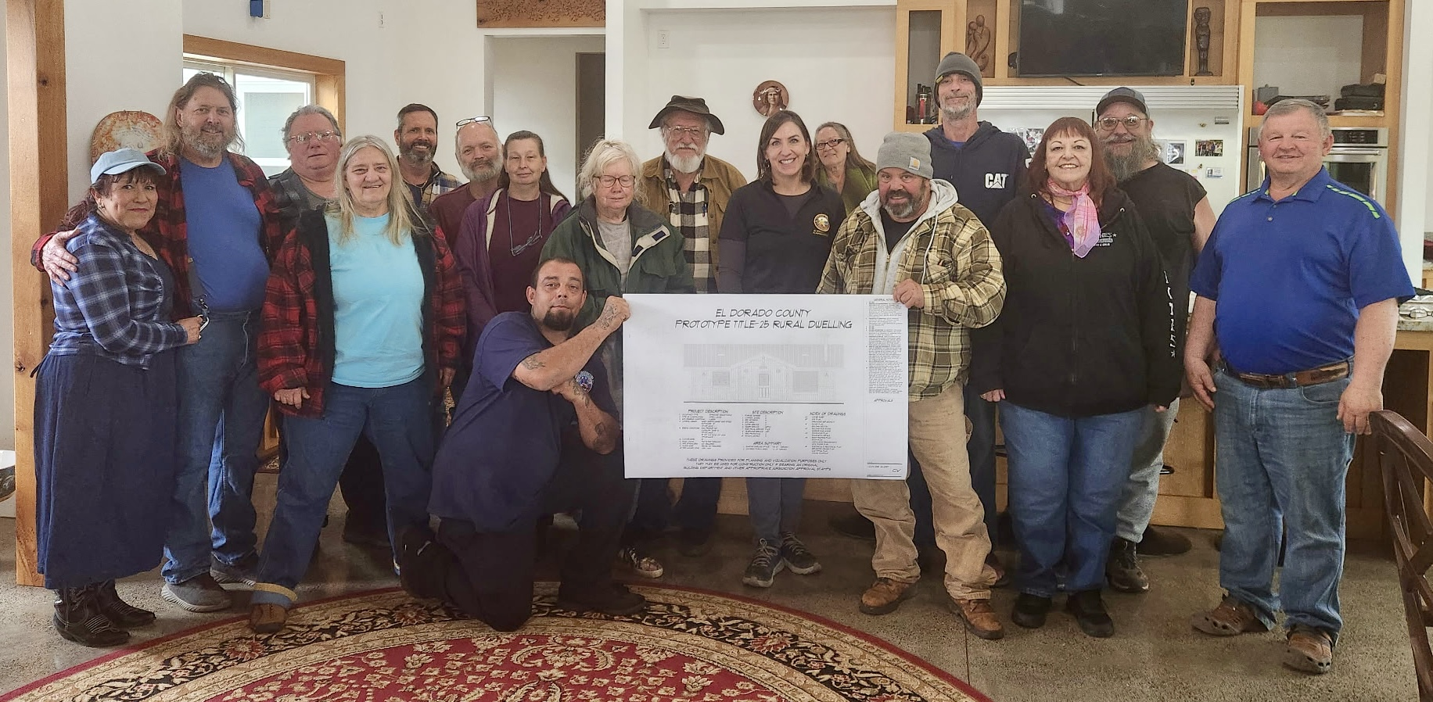
Local Workforce Development: Paid Training and Empowerment for Fire-Affected Residents
Paid Training Programs
Offering paid training empowers fire-affected residents with valuable construction skills for rebuilding efforts and social services.
Skill Development and Empowerment
Training fosters economic self-reliance by developing skills within a community to support independent employment pursuit
Community-led Rebuilding
Equipped residents can contribute directly to reconstruction, strengthening community resilience and recovery.
Notes:
--- Recovery plans include paid training programs to equip affected residents with construction skills, enabling them to participate directly in rebuilding efforts and fostering economic self-reliance. Image source: Microsoft 365 content library

Slide 13
Expanding Community Support: NPC Base Programs in Tuolumne County
Notes:
Beyond fire recovery, NPC offers a broad range of programs aimed at supporting diverse community needs, enhancing overall wellbeing and inclusivity.

Slide 14
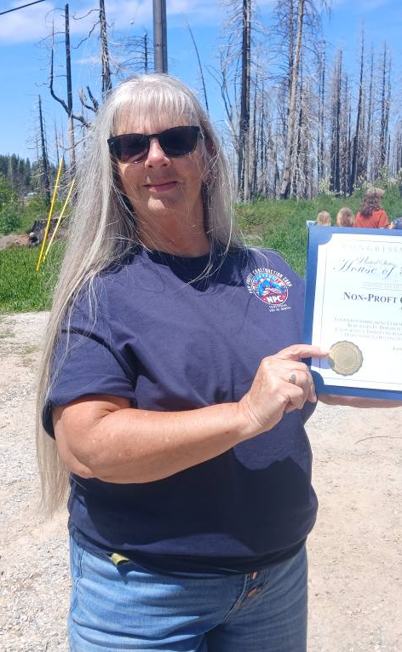
Overview of NPC’s Programs Beyond Fire Recovery
Home Rehabilitation Services
NPC offers free home rehabilitation to help families recover and rebuild Safe living environments after crises and abroad in the community.
Counseling Support
NPC partners provide counseling to support the emotional and psychological well-being of vulnerable populations navigating homeownership and rebuilding.
Specialized Assistance Programs
NPC offers specialized assistance tailored to vulnerable groups to address unique community needs. All services are provided free of charge when local government, state and federal funding can support our services. Homeownership for the broader community, Veteran Home improvement Program, Subsidized Manufactured Housing Opportunity program, Section 8 HCV and HUDVASH Homeownership
Notes:
--- NPC provides services such as home rehabilitation, counseling, and specialized assistance to vulnerable populations, strengthening community infrastructure. Image source: Microsoft 365 content library

Slide 15

Veteran Home Improvement, Home Rehabilitation, HUD Housing Counseling
Home Repair Assistance
Programs provide veterans with necessary home repairs to ensure safe and comfortable living environments and encourages local vets to participate in their local VFWs and other veteran service providers.
Home Rehabilitation Support
General rehabilitation services help improve and maintain housing quality for veterans and all low and moderate income families.
HUD Housing Counseling
Veterans and Families receive HUD-certified counseling through a collaborative third party agency to enhance housing stability and financial literacy.
Notes:
--- Targeted initiatives assist veterans with home repairs, support general home rehabilitation, and offer HUD-certified housing counseling to improve housing stability. Image source: Microsoft 365 content library

Slide 16

Support for Seniors, People with Disabilities, Youth, and Equity Access Initiatives
Equitable Resource Access
NPC programs provide fair access to vital resources for seniors, people with disabilities, and youth.
Barrier Reduction
Efforts focus on identifying and removing barriers that limit inclusion and participation in society such as the development of a service campuses with integrated supportive needs.
Promoting Inclusion
Programs encourage inclusive environments fostering empowerment and equal opportunities for all groups.
Notes:
--- NPC’s programs ensure equitable access to resources and support for seniors, persons with disabilities, and youth by addressing barriers and promoting inclusion. Image source: Microsoft 365 content library

Slide 17
NPC’s Model and Reinvestment Strategy
Nonprofit Operational Model
NPC functions as a nonprofit organization committed to community benefit over profit generation. It is about reinvestment and uplifting those in generational cycles of poverty, not creating reliance on those services.
Savings Reinvestment
Savings and revenues are reinvested to fund community projects and enhance service quality. By expanding our reach, engaging local government we create an adaptive system of reinvestment rather than exclusion and compartmentalized resources
Cost Reduction for Residents
Reinvestment helps lower costs for residents, making services more affordable and accessible.
Notes:
--- NPC operates as a nonprofit ensuring that savings and revenues are reinvested into community programs, reducing costs for residents while enhancing service quality. Image source: Microsoft 365 content library

Slide 18
Bringing Services Full Circle
Integrated Community Services
We combine programmatic services with affordable housing development to promote holistic and sustainable community growth. Reinvestment from those affordable housing developments is how we infuse growth in our schools, in communities, our homes and in our childrens future.
Reinvestment for Local Impact
Subsidies are reinvested to support schools, organizations, and job creation, benefiting the local community directly. Reinvestment from those affordable housing developments is how we infuse growth in our schools, in communities, our homes and in our children's future. Helping families exit welfare, see their dilemmas eye to eye and provide our mother and fathers with the knowledge they need to set their children up for financially independent futures.
Alignment With Local Plans
Our work aligns with residents, clients, and government plans, ensuring development meets housing, land use, and general goals. Working with regional housing authorities, coordinated entry service providers and other community based non-profits is how we sustain our commitments and plans for our future.
Notes:
Image source: Microsoft 365 content library We integrate programmatic services while developing affordable housing, fostering holistic community growth. By reinvesting subsidies, we support local schools, fund mission-aligned organizations, and create jobs. Our efforts align with residents, clients, and local government plans, ensuring community development meets housing, land use, and general plan goals for lasting, positive impact.

Slide 19

Ensuring Cost Savings and Economic Stability for Residents
Nonprofit Efficiencies
Utilizing nonprofit organizations enhances resource allocation to reduce housing expenses effectively. Without employing outside contractors that bid on local projects but are not uplifting the community. We apply in partnership with local governments to aggressively pursue the dollars available to us together or independently
Local Partnerships
Collaborations with local partners strengthen community efforts toward economic stability and affordable housing. If we are able to partner, support and expand local organizations this is an internal initiative in bolstering local service providers.
Economic Stability Promotion
The recovery approach fosters affordable housing to ensure long-term economic stability for residents. The affordable housing provides stability
Notes:
--- By leveraging nonprofit efficiencies and local partnerships, the recovery approach aims to lower housing costs and promote economic stability for Tuolumne County residents. Image source: Microsoft 365 content library

Slide 20
Conclusion
Community-First Recovery
Tuolumne County should prioritize community needs in its recovery efforts from recent impact. Creating housing stability, long term recovery, affordable housing and job creation. We come not as only a service provider with efficient skills and expertise, but as a new community based organization with a willingness to collaborate and elevate the community with every service we can provide.
Resilience and Commitment
Sustainable on-going resilience and commitment are crucial for rebuilding lives and strengthening the community. This is where partnering with Non-profit Construction Corporation will strengthen community impact and support long term partnerships. Providing affordable housing solutions not only to current renting families but in elevating all low and moderate income families to homeownership and generational wealth.
Disaster recovery rebuilding services and mitigation. Affordable housing for Veterans and low-income demographics, Homeownership, home rehabilitation and community development and job creation. That is NPC
Notes:
Tuolumne County’s community-first approach to recovery from the Chinese Camp CZU Lightning Complex Fire demonstrates how collaboration, resilience, and sustained commitment can rebuild lives and strengthen communities for the future.

